Slide 1

Procure to Pay: Creating and Managing Procurement
Training
Robin Smith
Procurement Specialist
Procurement, Contract and Grant Administration
Thursday, November 1, 2018

Slide 2

Introduction – About DPCGA
A little bit about us…
Kevin Jones, Deputy Director of Procurement, Contract, and Grant Administration (DPCGA)
Robin Smith, Procurement Specialist, “Buyer”
  The Office of Procurement concentrates on the bid solicitation process, terms contracts, etc. and oversees the purchasing functions of the GEARS system, including:
  Contracts
  Requisitions
  Purchase Orders
  Express Purchase Orders
  Judiciary’s Procurement Credit Card (P-Card) Program

Slide 3

Introduction – About DBF
A little bit about us…
Laura Jones, Director District Court Finance
Larry Tucker, Deputy Director- District Court Finance
  The Department of Budget and Finance handles the accounting, budgeting, and financial services of the Judiciary. Key functional responsibilities include:
  Accounts payable / Receivable / Revenue
  Justification and execution of the Judiciary budget
  Oversight of the security and operational aspects of the financial computer operating system (GEARS).

Slide 4

Introductions – Welcome!
Introduce Yourself…
Your Name
Your Title
Your Court/Program Location

Slide 5
Agenda and Training Objectives
By the end of training, you will be able to:
Understand the lifespan of a Procure to Pay Document
Define how different types of purchases are handled at the Judiciary
Understand in general terms how the Judiciary does business
Explain the purpose of the Chart of Accounts (Chartfields)
Explain the different features of the GEARS purchasing system and how they function together
Understand, create, and manage: Requisitions, Purchase Orders (POs)
Understand how to receive goods and services
Understand how to voucher and invoice for paying vendors
Understand various online inquiries and reports
Understand how to manage and maintain procurement documents

Slide 6
Life Span of a PTP Document
What is Procure-to-Pay (PTP)?

Slide 7
What Is Procure To Pay (PTP)?
A term used in the software industry to designate a specific subdivision of the procurement process
Procure-to-pay enables the integration of the purchasing department with the account payables department
All procurement related documents (purchase orders, requisitions, vouchers/invoices) must include the correct budget coding for proper allocation and validation of funding
Each court or program has a budget and/or grants established for spending throughout the fiscal year
Must become familiar with the correct budget codes for your court and/or program

Slide 8
Lifespan of a Procure to Pay Document
Purchase Order (PO)
Approval/ Dispatch
Receiving
Voucher
PO Reconciliation
PO Close
Requisition

Slide 9


Requisition
What is a Requisition?
Requisitions “pre-encumber” (reserve) dollar amounts from the budget before a PO is entered
All requisitions must be entered, budget checked, and approved before moving ahead in the process
When and Why is a Requisition Needed?
For any intended purchase that is more than $2500 ($500 for District Court) and/ or requires a corporate purchase order to be created
To enter into a contract for services or goods with a specific or an awarded vendor
Requisition
NOTE: When creating Requisitions for “service maintenance”,
be sure the serial number is listed on first part of the description

Slide 10

Purchase Order (PO)
What is a PO?
POs “encumber” (liquidates) the dollar amounts from the budget
Request to the vendor to order the goods / services
Commitment to purchase the goods / services from vendor
POs can be created from a requisition, a contract, manual entry or copying an existing PO
PO must be approved and budget checked before dispatching
When and Why is a PO Needed?
Express POs created by Field users purchases less than $2500 ($500 for District Court)
Regular POs created by Procurement, includes approved Requisitions sourced to a PO (assigned to a Buyer)
Two Types of POs
Quantity PO (for purchases that you can order in quantities)
Amount Only PO (for services-related purchases)
Purchase Order (PO)

Slide 11

Approval / Dispatch
What is an Approval?
Functionality which enables you to automatically trigger workflow notifications to inform the approver of the pending transaction
After successful budget check, Requisition is submitted for approval
POs are submitted for approval first; budget checked after approved
Required approvals may include: (1) local supervisor, (2) DBF Review (>$25K), and in some cases (3) JIS (for IT category purchases)
What is Dispatch?
PO must be approved and budget checked before dispatching
Purchase orders can be dispatched by email or by print
Dispatch sends copy of PO to vendor
POs must be dispatched before receiving and/or vouchering against PO
Approval/ Dispatch

Slide 12

Receiving
What is Receiving?
Once the goods (items) are received, it is required that you acknowledge so in GEARS system by using Receipts
You have the ability to partially receive or fully receive the goods (items)
Receiving
NOTE: More on receiving/receipts in GEARS later in the training session

Slide 13

Voucher
What is a Voucher?
In general:
After the PO (good or service) has been received in full or in part, the vendor may send you an invoice
The PO number and/or the Receipt number is used to pull the information into the Voucher screen for payment
Accounts Payable will use the voucher/invoice information to reconcile budgets and to submit vouchers to the State for payment
Voucher

Slide 14

PO Reconciliation
What is a PO Reconciliation?
Purchasing documents (POs/Requisitions) that will no longer be utilized to purchase goods or services or that has completed its purchasing lifecycle through to payment, should be closed
Reconciling POs, requisitions, and receipts involves running inquiries and reports to determine which of these items can be closed
PO Reconciliation

Slide 15
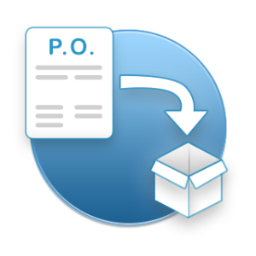
PO Close
What is a PO Close?
This is the process run to remove POs (and Reqs) that are received in full, canceled, or will no longer be needed to purchase goods/services
PO Close

Slide 16

How the Judiciary Does Business
Tracking Purchases

Slide 17
Doing Business at the Judiciary
Budgeting
Allocating Funds:
Operating
Grants
Judiciary’s Fiscal Cycle
(Jul – Jun)
Managing
Spending
Using reports to manage spending:
Purchasing and paying for goods and services:
PO Buydown Report
Voucher Inquiry
Budget Detail
Vouchers (Invoice)
Requisitions
Purchase Orders
Expenses

Slide 18
GEARS Purchasing Modules Flow
Purchase from a Vendor
Receive Goods / Services
Procurement Contracts
Purchasing Module
(Contracts, Requisitions, Express Purchase Orders, Corporate Purchase Orders, Receipts, Corporate P-Card)
Perform budget check from other modules
Commitment Control Module
(Controls expenditures against predefined, authorized budgets)
Accounts Payable Module
(Vouchers / Invoices)
Pay a Vendor (companies and individuals)
Create vouchers for payment

Slide 19
Tracking Purchases Against Budget
What is the Chart of Accounts (COA)?
An organized listing of an organization’s accounts that helps track financial transactions against the correct budget
Segregate expenditures, revenue, asset and liabilities
Allows for sophisticated financial reporting
Known as ‘Chartfields’ in GEARS system

Slide 20
Overview of the Judiciary’s COA/ Chartfields
Account
Batch Agency
Fund
Program
Approp Number
Approp Year
PCA
Seven fields of information
When combined define the proper allocation of transactions within general ledger, budgeting and procure to pay, i.e. PO’s, vouchers
The type and purpose of the transaction determines which Chartfields to complete
All fields of the Chartfields are required to define and validate funding
For more details regarding budget and finance chart of accounts and object codes and definitions, visit the budget and finance site at: http://courtnet/finance/index.html

Slide 21
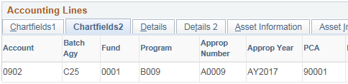
Judiciary’s Chartfields in GEARS
1
2
3
4
5
6
7
1 | Account | This represents how the expense is being categorized (e.g., 0902 – General Office Supplies, 0809 Equip Maintenance & Repair)
2 | Batch Agency | Identifies AOC and Circuit Court (C25) vs District Court (C50)
3 | Fund | Type of money being spent, e.g., general vs special fund
4 | Program | Identifies the court or program (e.g., B004 – District Court)
5 | Appropriation Number | Identifies the appropriation program in which the program resides under
6 | Appropriation Year | The budget year that the money was assigned to be expensed from. The year is based on when the fiscal year ends. (State Fiscal Year runs July 1 – June 30). e.g., AY2019 for spending during July 1, 2018 and ends, June 30, 2019. For past encumbrances and accruals, the AY entered would be from a previous year.
7 | Program Cost Account (PCA) | Identifies the court or program responsible for the transaction (e.g., 90001 Judiciary Information Services)

Slide 22
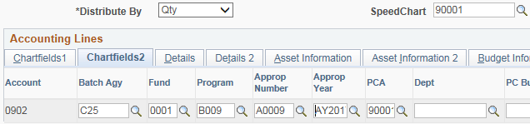
What is a SpeedChart?
A SpeedChart code is used to automatically populate 5 of the 7 fields that make up the Chartfield string
  Increases data efficiency by reducing the number of keystrokes
Enter your Program Cost Account (PCA) in SpeedChart field, the system auto populates (Batch Agency, Fund, Program, Appropriation Number, and PCA)
In most cases, you will need to enter the two other fields, account and Appropriation Year.
For Express PO’s only, the Account code will auto populate from the category
Enter the Appropriation Year (year is based on the year that the current fiscal year ends, unless the expense was accrued or encumbered)

Slide 23
Let’s take a break!
BREAK
10 min.

Slide 24
Creating Requisitions
Setting Up Procurement Documents in GEARS

Slide 25

Things to Remember When Setting Up Procurement Documents In GEARS
Record important information such as serial number and period of coverage dates in the Name and Item Description fields
  Helps to identify the purchase and expense
  Especially when creating requisitions for “service maintenance”
  Do no use special characters (e.g., ‘/:;) in the name; vouchers
Attach contracts to Express POs for blanket (BPO) contract vendors
Must set-up your Requisitions/Express POs in the manner in which you wish to Receive goods and services
  Goods/service at the SAME unit cost should be Quantity
  Service(s) with VARYING price should be Amount Only Unit of measure (UOM) for “Amount Only” purchase documents should be AMT
Remember to check the Amount Only checkbox, if you are creating an “Amount Only” purchase document
  Located under the Attributes section on the Line Details icon
Know the correct budget codes (PCA) for your transaction(s)

Slide 26
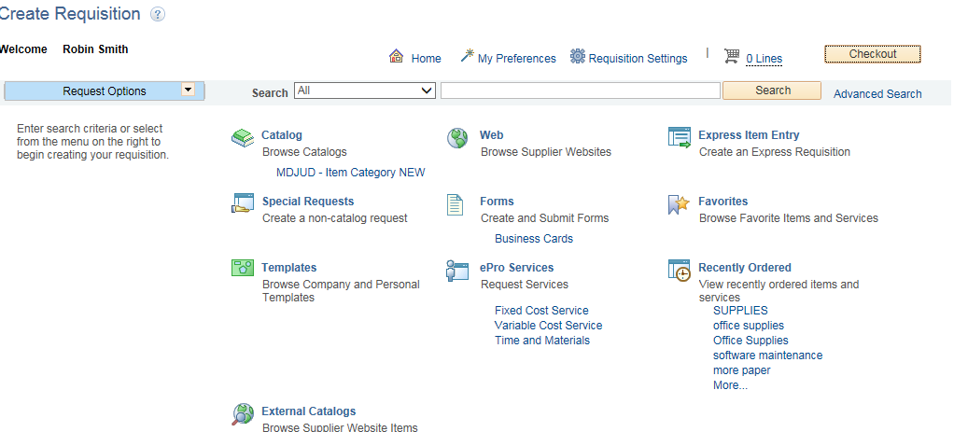
Creating A Requisition
Create Requisition
Clink here Requisition Setting

Slide 27
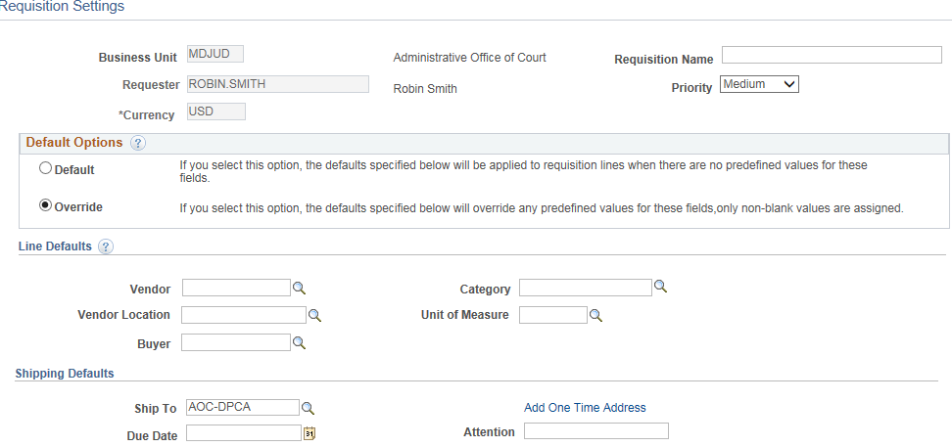
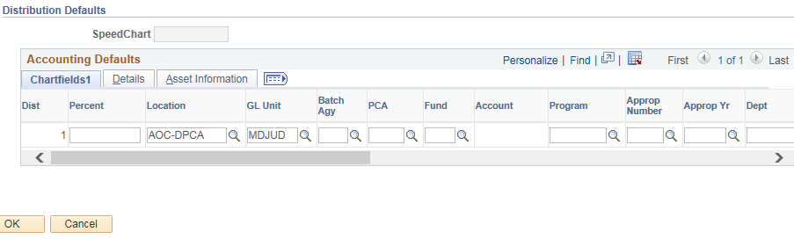
Creating A Requisition
Requisition Settings
1. Fill in requisition name- something you can identify with for future use.
2. Click on Override button - The defaults entered will populated on ALL your requisition lines.
3. Fill in your SpeedChart info. Everyone should know there Program Information
1
2
3

Slide 28
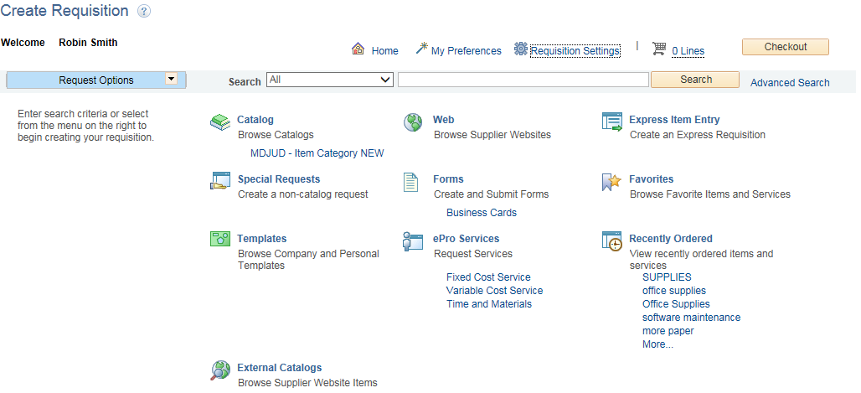
Creating A Requisition
Click on Special Requests

Slide 29
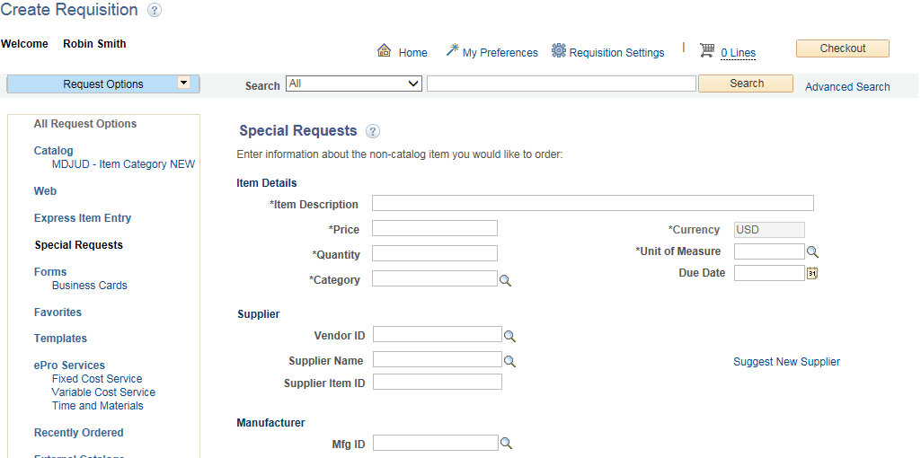
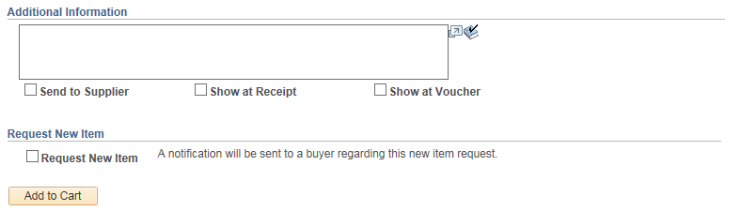

Slide 30
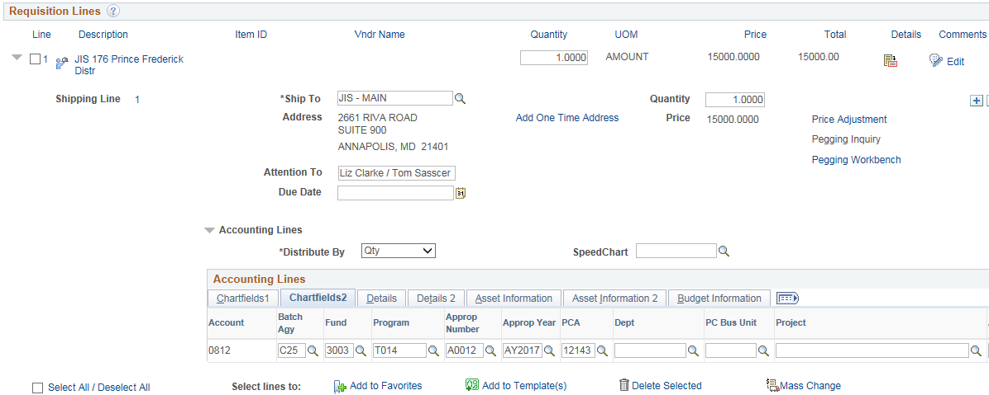
Creating A Requisition
Review and Submit – Add Ship To, Distribute By (Quantity vs Amount), Accounting Lines (Chartfields / SpeedChart), Req Header Comments

Slide 31
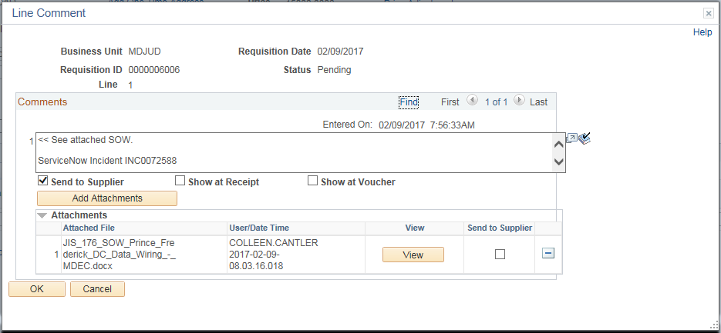
Creating A Requisition
Enter Req Line Comments and Attachments (e.g., quotes) – click ‘Send to Supplier’ box for Vendor to see comments

Slide 32

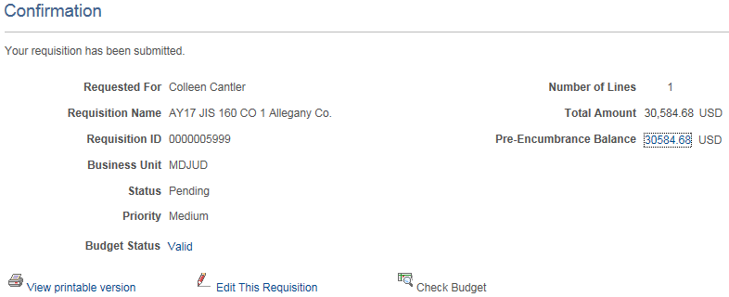
Creating A Requisition
Save & Preview Approvals / Check Budget – Check and validate budget before submitting for approval. GEARS assigns Req ID number, verify total amounts, number of lines, etc.;

Slide 33
Creating A Requisition – Your Turn
Contractor/Vendor Supplier Solicitation
Vendor: | N/A
Description: | Solicitation for Professional Movers
Category ID: | 0826
PO Qty.: | 1 (Amount)
Justification: if needed | Needed to move all electronic equipment and install furniture with the new office location for (your name)
Merchandise Amount: | $3,000.00 – price is estimated.
Comments: | Solicit for bids and ensure that movers can meet all requirements to disassemble and reassemble all furniture & equipment form old location to new properly. Can attach additional information rooms.

Slide 34
Creating PURCHASE ORDERS
Setting Up Procurement Documents in GEARS

Slide 35
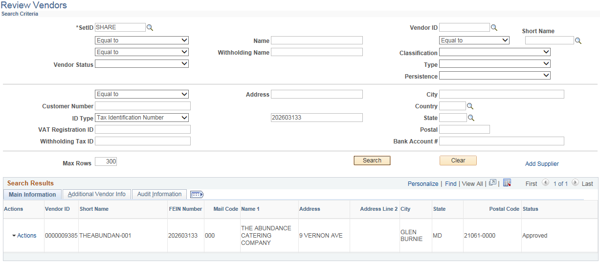
Before You Begin – Look Up Vendor First
Review Vendors – look up by Tax Identification Number, Social Security Number or by Name (must verify address); If Vendor is not correct, the voucher will not process accurately and must redo documents

Slide 36
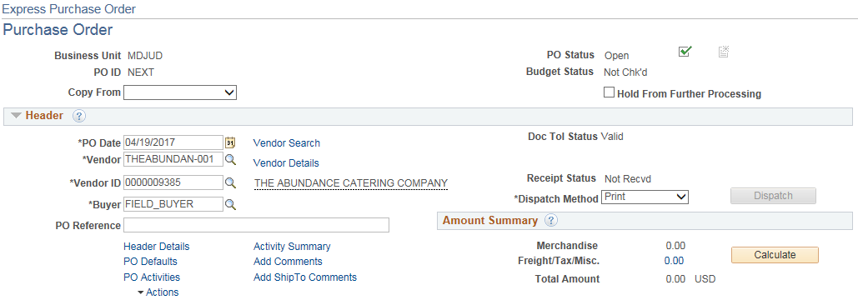
Creating an Express PO
Purchase Order Header – Enter Vendor ID/Vendor (ID from Review Vendor page); enter PO Reference (e.g., Catering – Fall Conference)

Slide 37
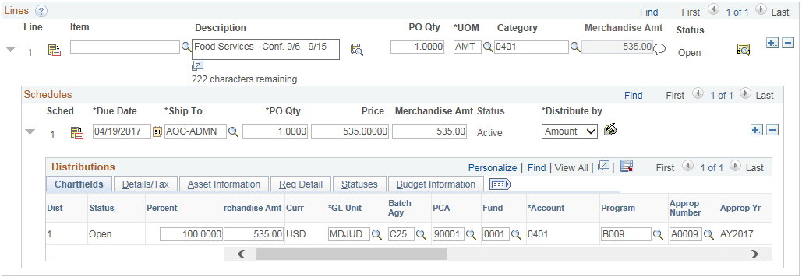
Creating an Express PO
Purchase Order Line Information – description, PO Qty, Unit of Measure (Amt or Ea), Category,
Schedules – Due Date, Ship To, Price, Distribute By (Amount vs Quantity),
Distributions – Chartfields (including Bath Agency, Fund, Program, Approp Number, Approp Year, Account, PCA)

Slide 38
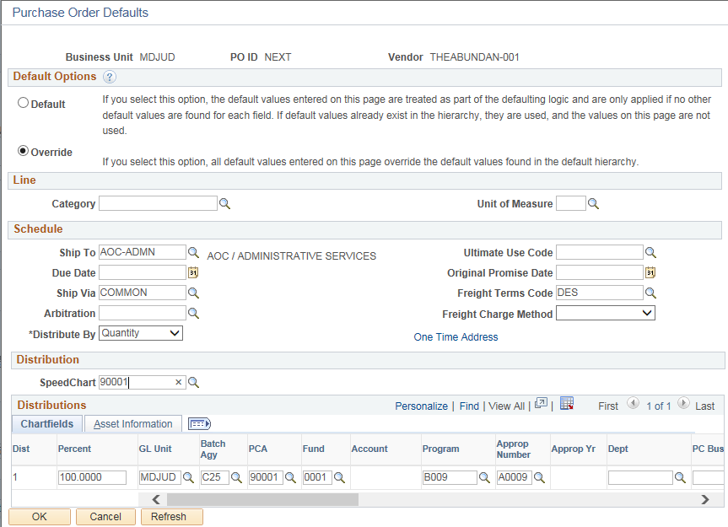
Creating an Express PO
PO Defaults Link – Use the SpeedChart field to populate 5 of the 7 Chartfields fields (Batch Agency, Program, Approp Number, Fund, and PCA); you can manually add the Approp Year (e.g., AY2019)

Slide 39
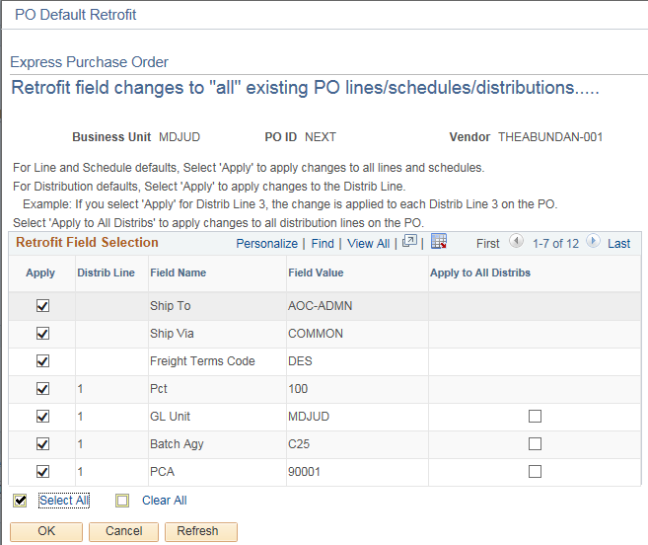
Creating an Express PO
Apply SpeedChart to all PO Lines, Schedules, and Distributions – Click Select All and OK

Slide 40
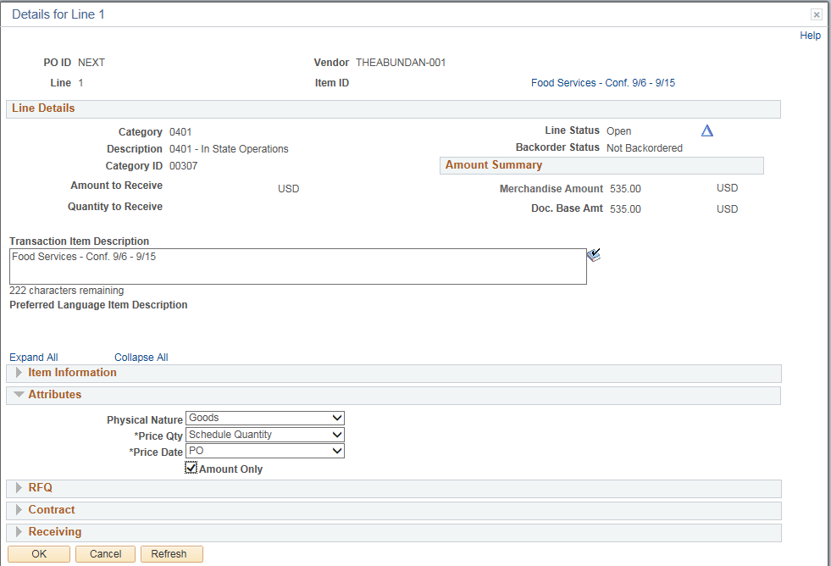
Creating an Express PO
(For Amount Only Pos) Line Details > Attributes / Assign Amount Only – Click Amount Only checkbox

Slide 41
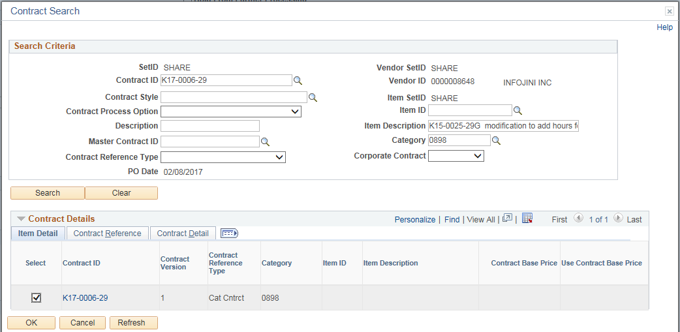
Creating an Express PO
(For Contracts) Contract Search > Attach the Contract – Click Search button. Choose contract and click OK.
Once you click Search, the active ‘Contract ID’ associated with the vendor populates. Select the checkbox and click ‘OK’

Slide 42
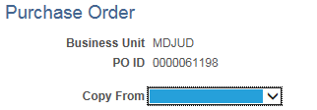


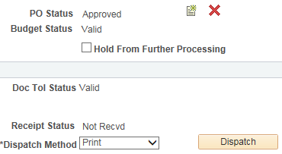
Creating an Express PO
Save, Submit for Approval, Budget Check, Dispatch PO
Save PO, GEARS assigns PO Number
Submit PO for Approval
After Approval, perform the Budget Check
After Budget Check, Check Budget Status
Choose Dispatch Method and Dispatch PO

Slide 43
Creating Express POs – Your Turn- using BPO
Amount Only
DATA TITLE | DATA INFORMATION TO BE VIEWED OR WRITTEN IN EXERCISE
VENDOR: | SHURA INC.
PO AMOUNT ONLY | AMT. ONLY CHECKBOX | CONTRACT ID | K16-0064-25
CATEGORY | 0401 In State Operations
UNIT OF MEASURE | AMT. ONLY
MERCHANDISE AMT | $225.00
JUSTIFICATION | N/A
COMMENTS | FOOD SERVICES FOR COURT OPERATION TRAINING
Notes:
Range: 0000043038 – 49, 21

Slide 44
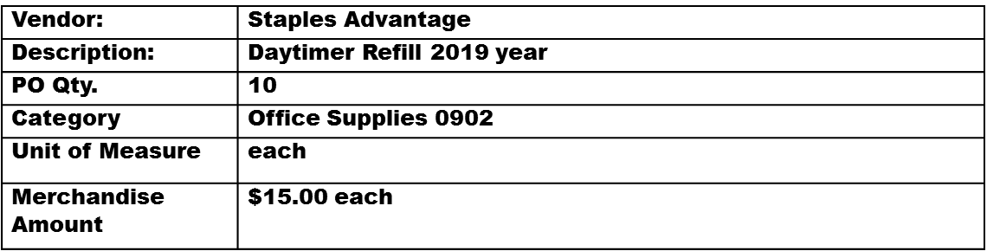
Creating Express POs – Your Turn
Quantity Based
Description: | Manila File Folders 100/pk.
PO Qty. | 5
Category | Office Supplies 0902
Unit of Measure | box
Merchandise Amount | $9.00 bx.
Notes:
Range: 0000043050 – 59, 24

Slide 45
Creating Express PO’s –Your turn using BPO
Amount Only
DATA TITLE | DATA INFORMATION TO BE VIEWED OR WRITTEN IN EXERCISE
VENDOR: | MARYLAND CORRECTIONS ENTERPRISE
PO AMOUNT ONLY | AMT. ONLY CHECKBOX | CONTRACT ID | BPO000034063-2017
CATEGORY | 0902 OFFICE SUPPLIES
UNIT OF MEASURE | AMT. ONLY
MERCHANDISE AMT | $500.00
JUSTIFICATION | N/A
COMMENTS | NAME PLATES: 1. AVERY CLARK – LAWYER NAME PLATES: 2. BILL JONES – CHIEF CLERK NAME PLATES: 3. HONORABLE CHRIS WALL - JUDGE

Slide 46
Managing Procurement Documents
Procurement Documents in GEARS

Slide 47
Managing Documents in GEARS
Requisitions & Express POs
  Find Documents
  Edit Documents
  Copy Documents
  Cancel Documents
Receipts
  Find
  Looking at Information inside document
GEARS Reports Matrix

Slide 48
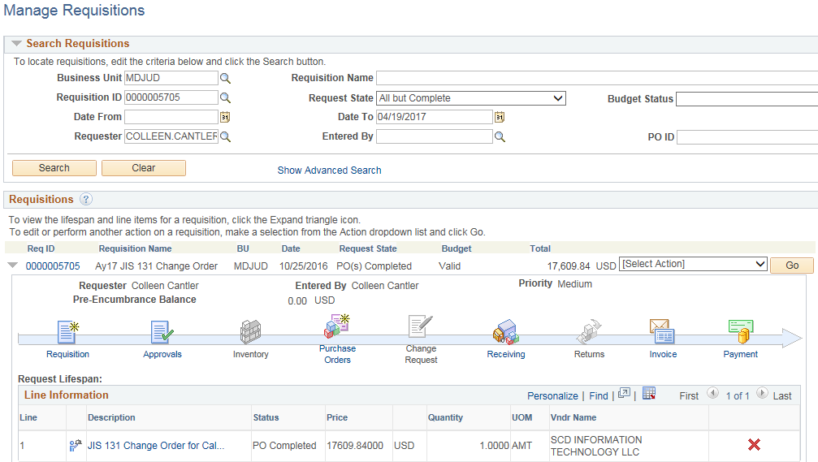
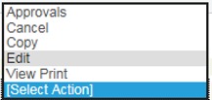
Manage Requisitions – Sample Activity Timeline
Requisition Activity – activity status timeline, actions: cancel, copy, edit, view approvals, view printable version

Slide 49
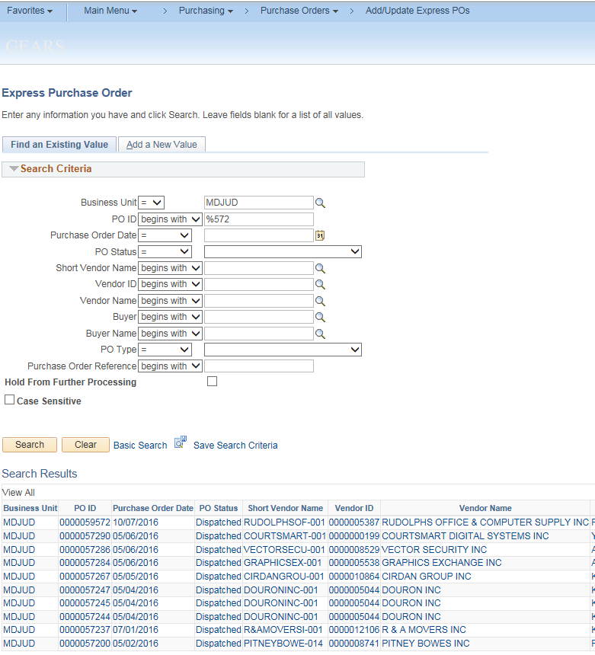
Finding Your Express POs
Main Menu > Purchasing > Purchase Orders > Add/Update Pos > Find Existing Value

Slide 50
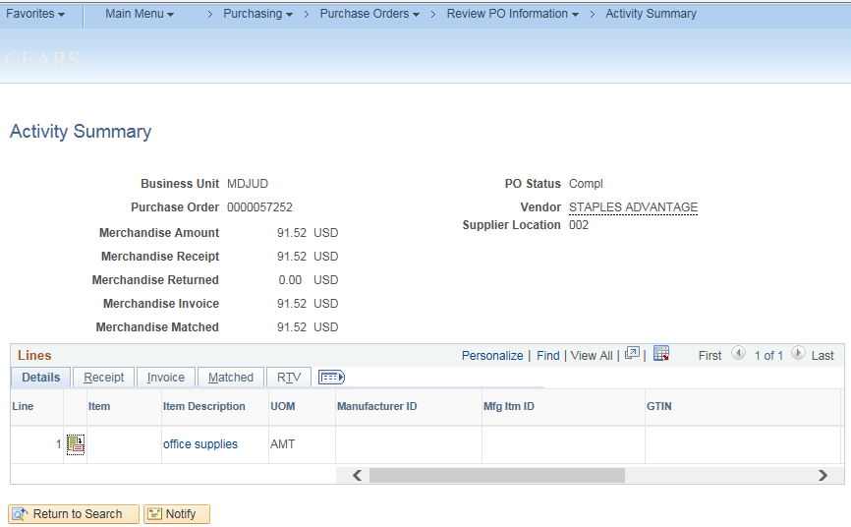
Finding Information on Express POs
Activity Summary – view receipts, invoices, and match related to the PO

Slide 51
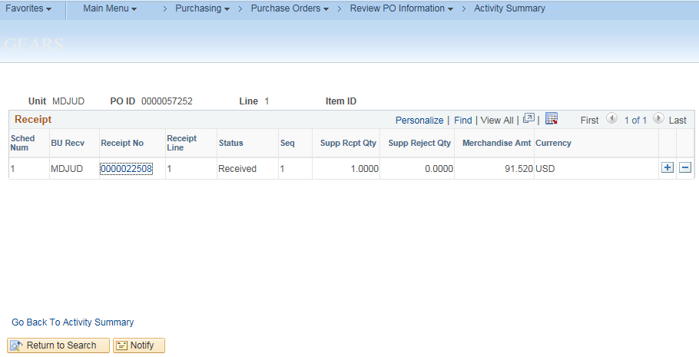
Finding Information on Express POs
PO Activity Summary – Receipt Info

Slide 52
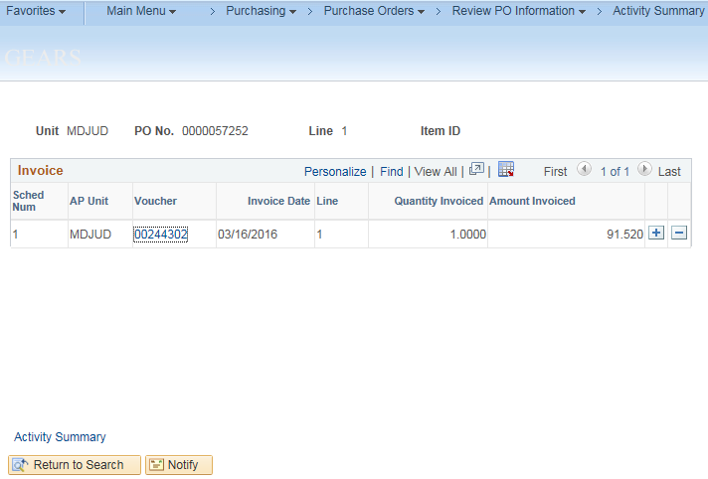
Finding Information on Express POs
PO Activity Summary – Voucher Info

Slide 53
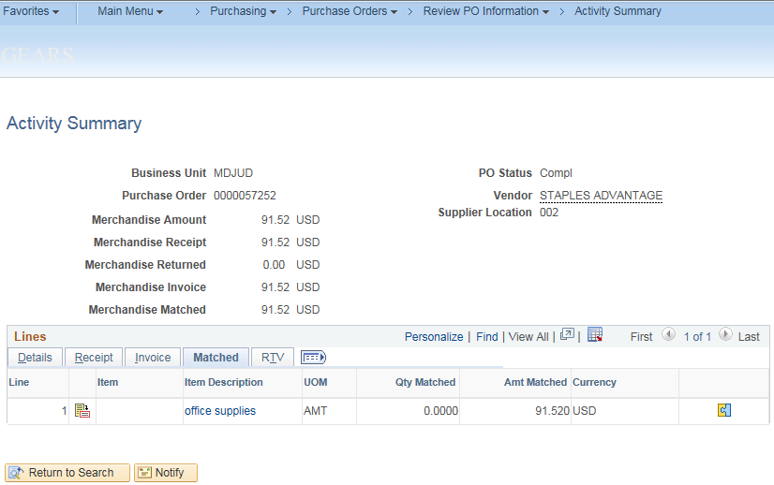
Finding Information on Express POs
PO Activity Summary – Matched Info

Slide 54
NEED A BREAK??
BREAK
10 min.

Slide 55
Monitoring Procurement Documents
Procurement Documents in GEARS

Slide 56
Monitoring Procurement Documents
Purchasing documents (POs/Requisitions) that will no longer be utilized to purchase goods or services or that has completed its purchasing lifecycle through to payment, should be closed
Monitor (Monthly)
Analyze and cancel requisitions no longer needed
Analyze and identify POs to be closed (Field)
Close eligible POs (DPGCA)
Close (Monthly / Year End)
Close ALL POs (except DBF Encumbered POs)
New POs to be issued for the remainder of contract period (POs that cross Fiscal Years)
Create (Year End)
Create and Submit new Reqs for POs with services beyond the Fiscal Year (6/30)
No prior year POs entered after Fiscal Year End
*based on AOC Procurement guidelines

Slide 57
Online Inquiry and Reporting Matrix
PO Buydown Report
PO Close Request Page
Acquisition Life Cycle- New

Slide 58
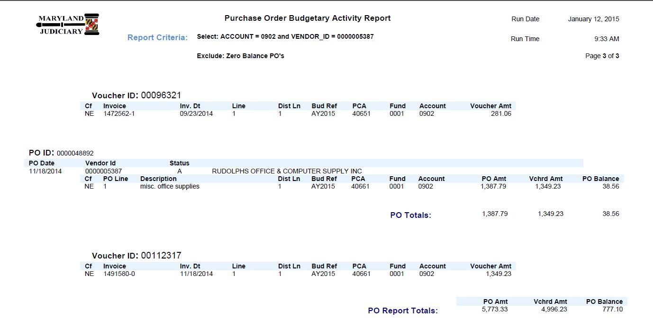
Invoice and Payment – Sample PO and Voucher Activity Report
*migration to Production (expected Jan, 2015)

Slide 59
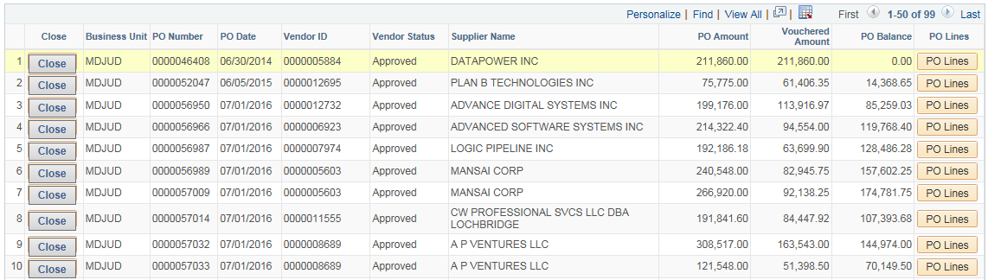
Managing Procurement Documents – Sample PO Close Request Page
*migration to Production (expected Jan, 2015)

Slide 60
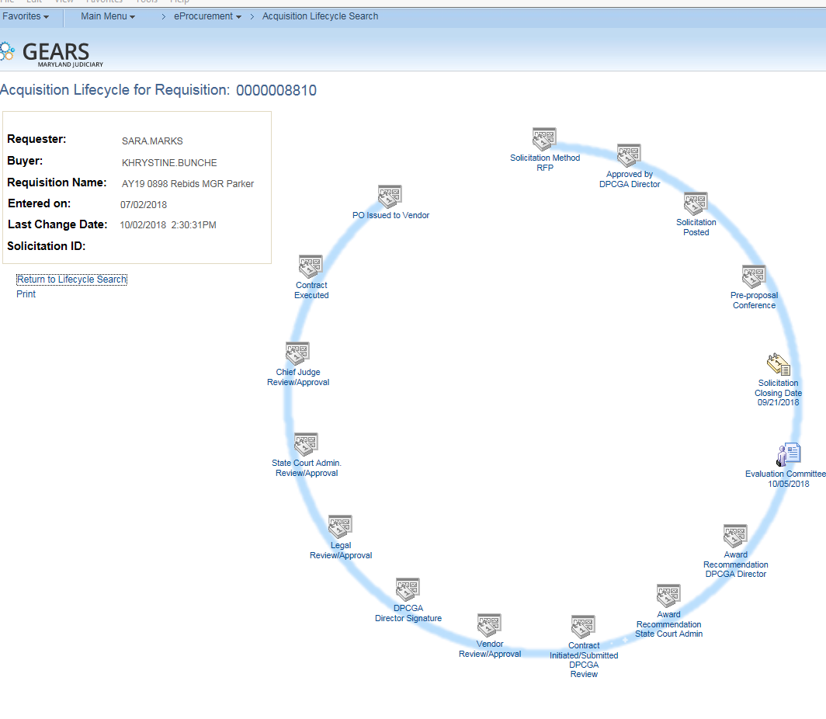
Acquisition Life Cycle New

Slide 61
Contacts and additional information
Resources and Tools

Slide 62
Additional Information
Vendors
  Find
  Which vendor to choose when creating documents?
  http://mdcourts.gov/procurement/pdfs/bpofy2019.pdf
When needing to add or update a vendor:
  Complete and submit Vendor Maintenance Form (GEARS Website > Forms)
http://mdcourts.gov/gears/pdfs/newsletter/vol1issue2/externalvendormaintenanceformfillable.pdf

Slide 63
Additional Information
Vendors
  Find
  Which vendor to choose when creating documents?
  http://mdcourts.gov/procurement/pdfs/bpofy2019.pdf

Slide 64
Additional Information
Vendors
  Find
  Which vendor to choose when creating documents?
  http://mdcourts.gov/procurement/pdfs/bpofy2019.pdf

Slide 65
Contact Us – DPCGA
PROCUREMENT CONTACT NAME | TITLE | PHONE NUMBER | EMAIL ADDRESS
Kevin Kelly | Director, Procurement | (410) 260-1594 | Kevin.Kelly@mdcourts.gov
Kevin Jones | Deputy, Procurement | (410) 260-1411 | Kevin.Jones@mdcourts.gov
Vacant | Manager, Procurement & P-Card Manager | (410) 260-1265
Robin Smith | Procurement Specialist | (410) 260-1421 | Robin.Smith@mdcourts.gov
Lisa Lee | Procurement Specialist & P-Card Administrator | (410) 260-1463 | Lisa.Lee@mdcourts.gov
Karen Hoang | Procurement Specialist | (410) 260-1582 | Karen.Hoang@mdcourts.gov
Yashica Forrester | Procurement Specialist | (410) 260-3591 | Yashica.Forrester@mdcourts.gov
Khyrstine Bunche | Procurement Specialist | (410) 260-1416 | Khrystine.Bunche@mdcourts.gov
Whitney Williams | Procurement Specialist | (410) 260-1265 | Whitney.Williams@mdcourts.gov
April Molley | Procurement Specialist | (410) 260-1538 | April.Molley@mdcourts.gov
Alisha Allmond | Procurement Specialist | (410) 260-1265 | Alisha.Allmond@mdcourts.gov
Lynne Kelleher | Grants Manager | (410) 260-1587 | Lynne.Kelleher@mdcourts.gov
Allison Leebrick | Travel & Catering Admin. | (410) 260-1417 | Allison Leebrick@mdcourts.gov

Slide 66

Just Ask…
Any Questions?

Slide 67

Great Job!!!
  Congratulations!!!!
  You have successfully completed the course!!!!

Slide 68

Thank You!!!

