Slide 1



Managing and Reconciling Purchasing Cards (P-Card)
Training Session
11/15/18

Slide 2


Introductions
A little bit about us…
Lisa Lee, Buyer and P-Card Administrator, Department of Procurement and Contract Administration (DPCGA)
Yashica Forrester, Procurement Specialist and backup to Lisa Lee
Trish Gugliotta, P-Card Reconciler, Department of Budget and Finance (DBF)
  The Department of Procurement (DPCGA) oversees the purchasing functions of the GEARS system (Judiciary’s Financial database). This includes, but is not limited to, Purchase Orders, Requisitions, as well as the Procurement Credit Card (P-Card) Program.
  The Department of Budget and Finance (DBF) oversees and manages the Judiciary’s budget and all related financial transactions. This includes, but is not limited to, vouchers and payment of corporate purchasing credit card statements.

Slide 3
Introductions – Welcome!
Introduce Yourself…
Your Name
Your Title
Your Court/Program Location

Slide 4
Session Topics
  Today’s Agenda
    Purchasing Card (P-Card) Account Set Up
    Managing and reconciling P-Card transactions in U.S. Bank
    Managing and reconciling P-Card monthly statements in GEARS

Slide 5
Course Objectives
Upon completion of this course, you should be able to:
Understand the difference between Purchasing Card processing in U.S. Bank versus GEARS
Understand how to register your Corporate Purchasing Cards on U.S. Bank’s Access Online site
Understand how to reconcile your corporate transactions and maintain record keeping of your corporate purchases
Understand what to do in case your card has fraudulent charges or has been lost or stolen
Understand who to contact for Corporate Purchasing Card policies, procedures, card maintenance
Understand how to perform beginning to end processing of P-Card transactions in GEARS

Slide 6
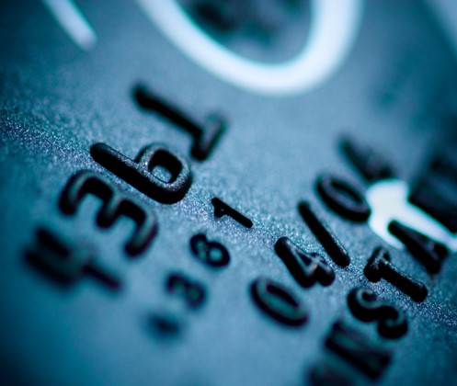
Difference Between U.S. Bank vs. GEARS
U.S. Bank
Issues Corporate Purchasing Cards for Maryland Judiciary
Cardholder account management for day-to-day purchasing transactions
GEARS
Maryland Judiciary’s Financial System
Loads monthly credit card statement of all Judiciary Corporate Purchasing transactions from U.S. Bank
Sends file of all Judiciary transactions monthly to GEARS
Cardholder updates merchant description and changes account (chartfield)
Commits funds from the budget
Vouchers created in GEARS to pay for Corporate Purchasing credit card statement

Slide 7
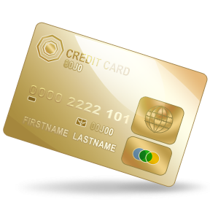
Purchasing Card Account Set Up in U.S. Bank
U.S. Bank will issue Corporate Purchasing Cards to cardholders based on the signed written approval of the State Court Administrator or designee
Cards issued with the employee’s name and with Maryland Judiciary embossed on the plastic
The Judiciary’s PCPA will issue cards to Cardholders
Cardholders must initially self-register your cards on U.S. Bank’s Access Online website
  https://access.usbank.com

Slide 8
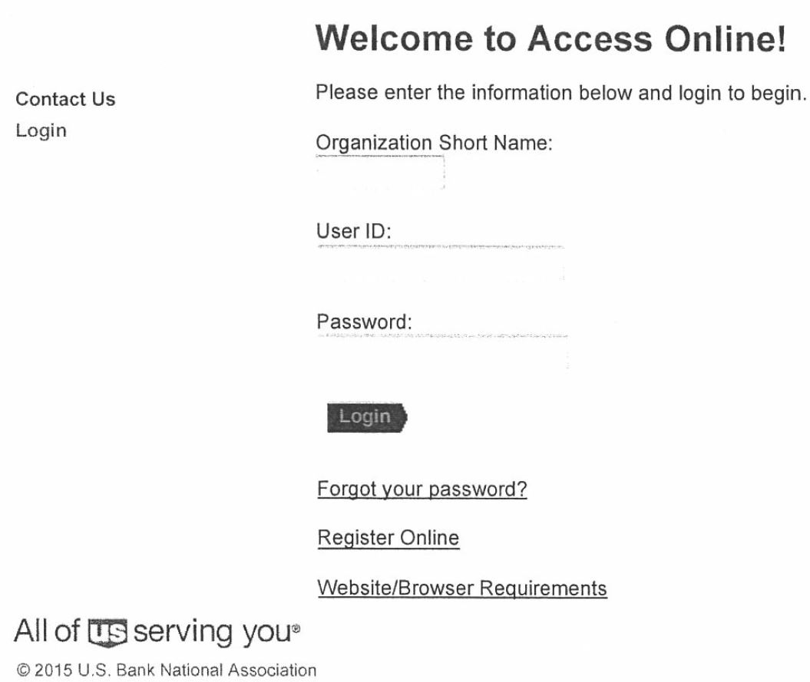
Purchasing Card Account Set Up in U.S. Bank

Slide 9
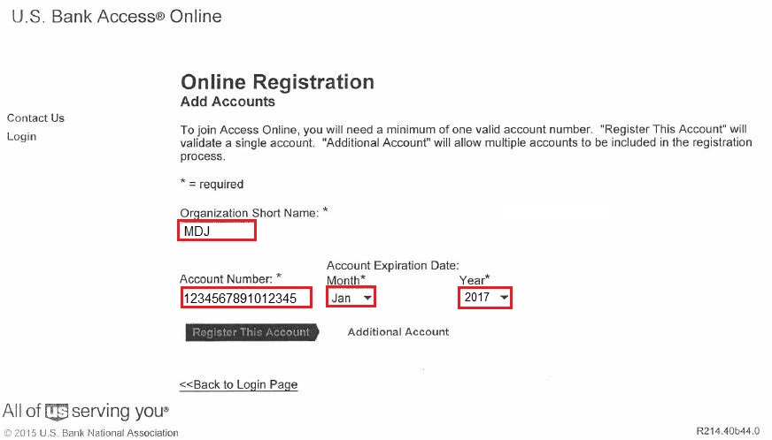
Purchasing Card Account Set Up in U.S. Bank

Slide 10
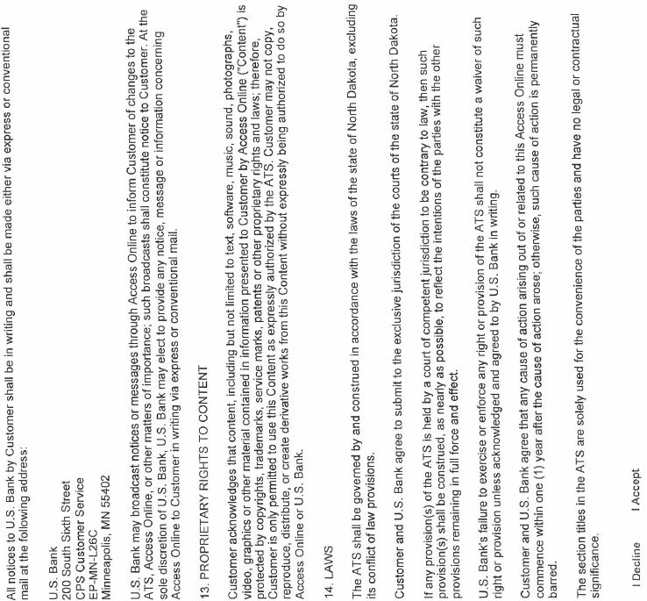
Purchasing Card Account Set Up in U.S. Bank

Slide 11
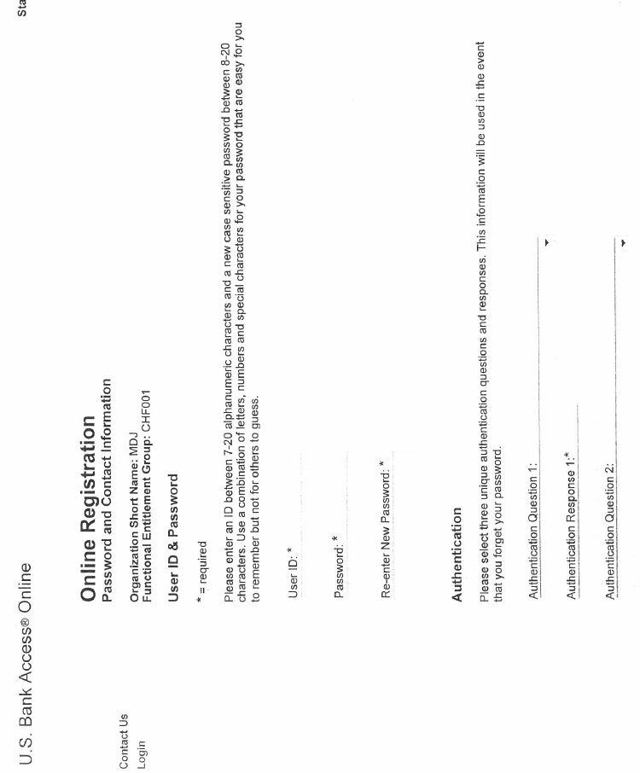
Purchasing Card Account Set Up in U.S. Bank

Slide 12
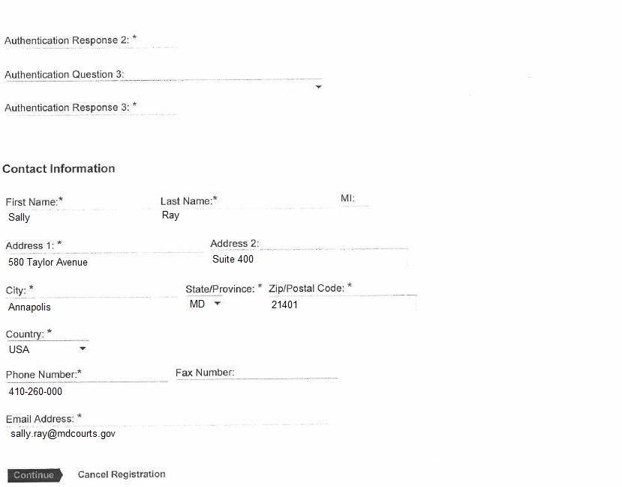
Purchasing Card Account Set Up in U.S. Bank
NOTE: Your Contact Information must be your Maryland Judiciary work information. For example, court location, work email address, and work phone number.

Slide 13
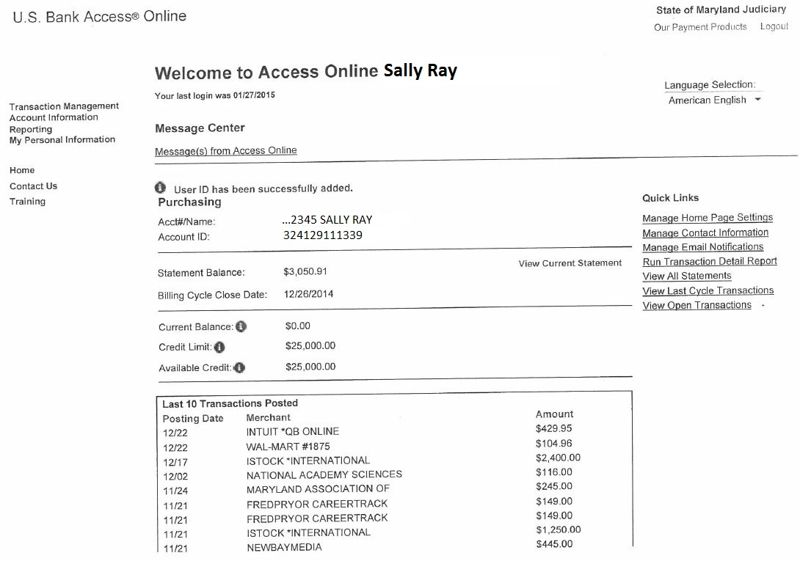
Purchasing Card Account Set Up in U.S. Bank

Slide 14
Maintaining Record Keeping of Purchases
A receipt is required for each transaction
Every transaction (charge or credit) must be recorded on Cardholder Transaction Log Sheet
  You will use this log to reconcile the monthly charges against the credit card statement
You are responsible for reconciling the Monthly Cardholder Statement with the Transaction Log sheet, attaching all receipts, signing, and returning the package to your immediate supervisor/manager.
Use U.S. Bank online account access to:
  Review daily charges/ensure charges are coded to correct account code
  Make corrections if necessary

Slide 15

Correcting Charge Codes in U.S. Bank
https://access.usbank.com

Slide 16
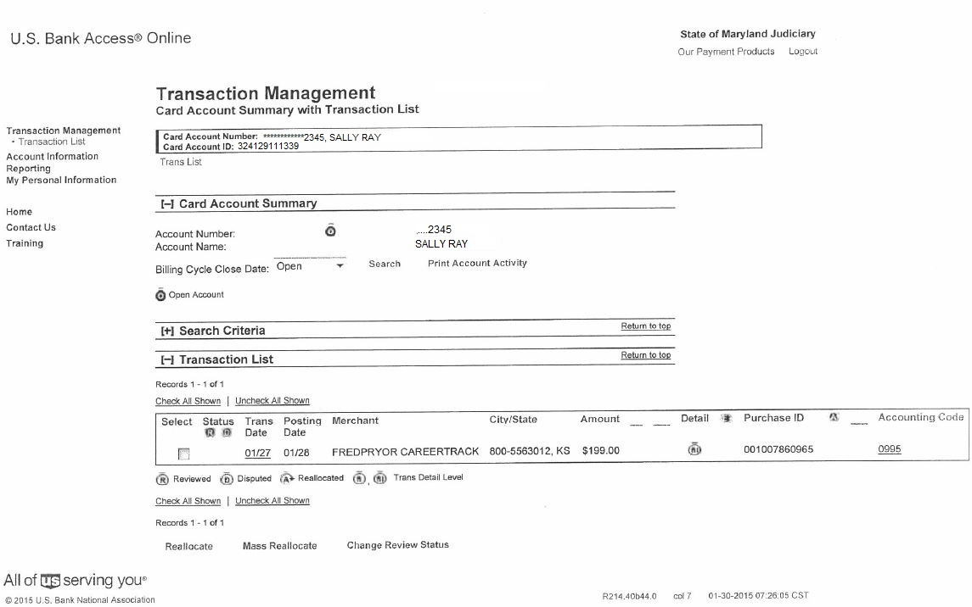
Correcting Charge Codes in U.S. Bank

Slide 17
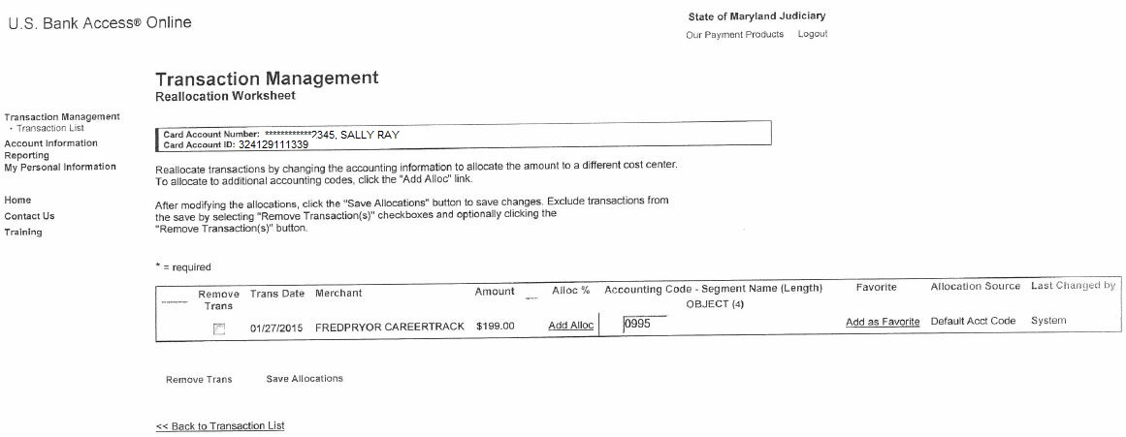
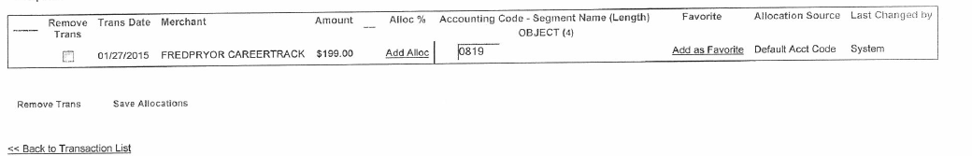
Correcting Charge Codes in U.S. Bank

Slide 18
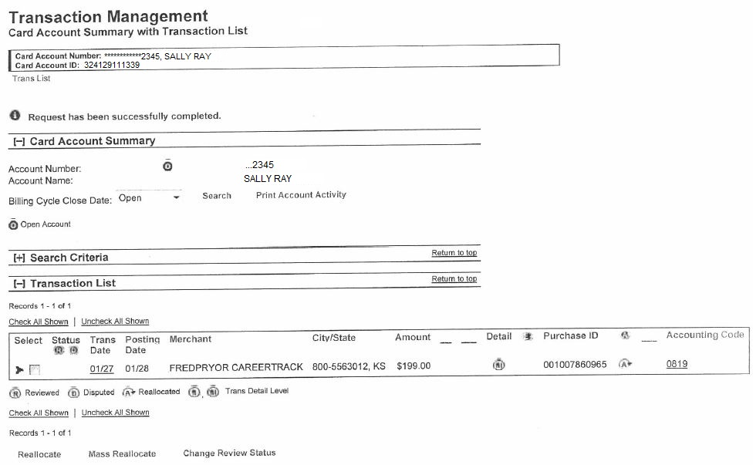
Correcting Charge Codes in U.S. Bank

Slide 19
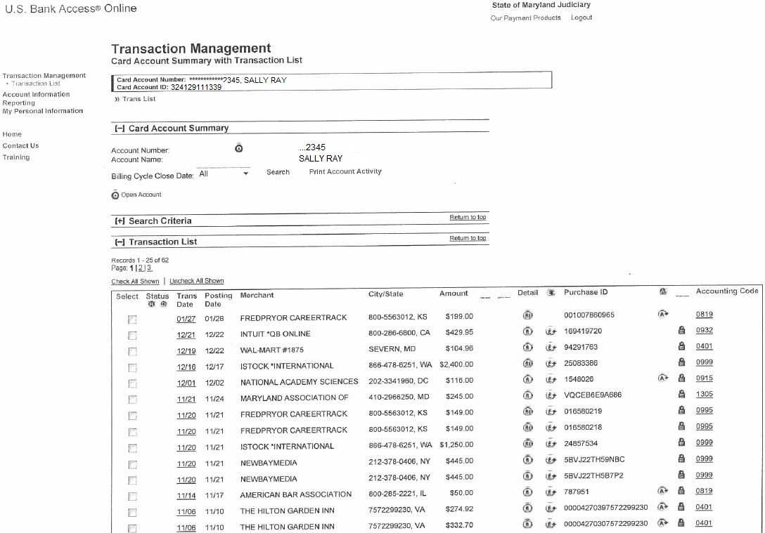
Viewing All Transactions in U.S. Bank
NOTE: If you made changes to an account code, there will be a symbol next to the transaction. The lock symbol next to a transaction means that you cannot make any more changes to an account code. Subsequent required changes must be made in GEARS.

Slide 20

How to Dispute Incorrect Charges or Amounts?
Dispute Incorrect Charges or Amounts
First, attempt to resolve with vendor
If no resolution with vendor, contact U.S. Bank
Post any credits to the Transaction Log
Notify the PCPA Immediately

Slide 21
What to Do In Case Your Card Has Fraudulent Charges, Been Lost or Stolen?
You must contact U.S. Bank’s Customer Service (800-344-5696) immediately
  Lost cards or fraudulent charges reported by telephone are blocked immediately
Notify the PCPA immediately of Lost or Stolen cards or if the card has fraudulent charges

Slide 22
Who to Contact for Corporate Purchasing Card Policies, Procedures, and Card Maintenance?
Purchasing Card Program Administrator (PCPA):
Lisa Lee, 410-260-1263 or Yashica Forrester, 410-260-3591
Purchasing Card Program Manager (PCPM):
General Cardholder and Procurement Information:
Lisa Lee, 410-260-1263 or Yashica Forrester, 410-260-3591
District Court Finance Manager:
Larry Tucker, 410-260-1206

Slide 23
NEED A BREAK??
BREAK
10 min.

Slide 24

performing P-Card transactions in GEARS

Slide 25
P-Card Monthly Statement Process Flow
U.S. Bank Ends Monthly Billing Cycle
Cardholder has 3 Calendar Days in U.S. Bank to Review and Change Account Coding
U.S. Bank Sends File to DBF
DBF Loads Monthly Statement in GEARS
DBF Notifies Cardholder
Cardholder has 3 Business Days to Perform Work in GEARS
P-Card Administrator Reviews and Approves the Transactions
DBF builds vouchers and prepares final preparation for P-Card payment
GEARS sends vouchers to the State for credit card (U.S. Bank) payment

Slide 26

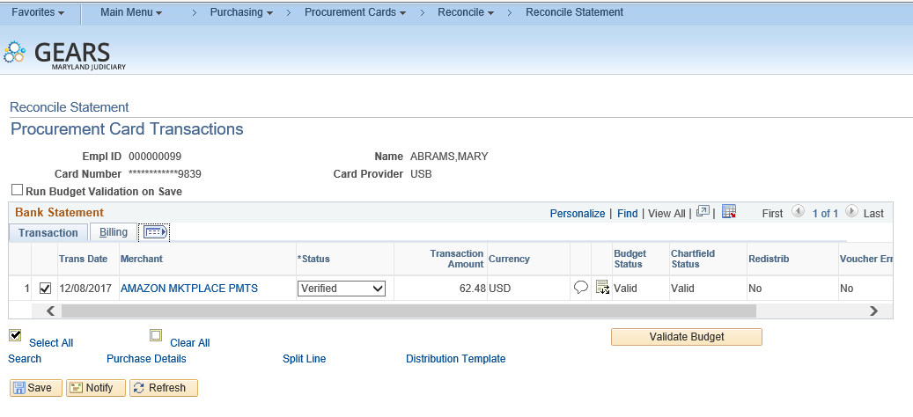
Cardholders Review of Monthly Statement in GEARS – Review Transactions
Review your monthly credit card transactions (in GEARS):
Click on the Expand tab.

Slide 27

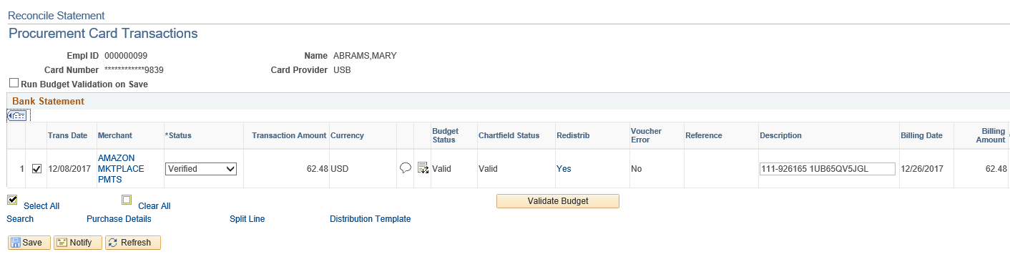
Cardholders Review of Monthly Statement in GEARS – Review Transactions
Click on the Distribute icon.

Slide 28

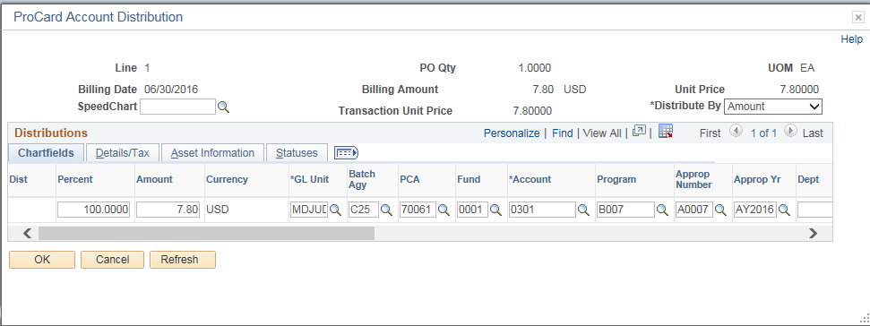
Cardholders Review of Monthly Statement in GEARS – Reconcile or Correct Distributions
Reconcile or correct any distributions.
  Modify ChartFields (e.g., account code or split distribution).
  All distribution lines with Account code ‘0995’ must be changed.
  NOTE you must perform budget check, if any changes to ChartFields

Slide 29

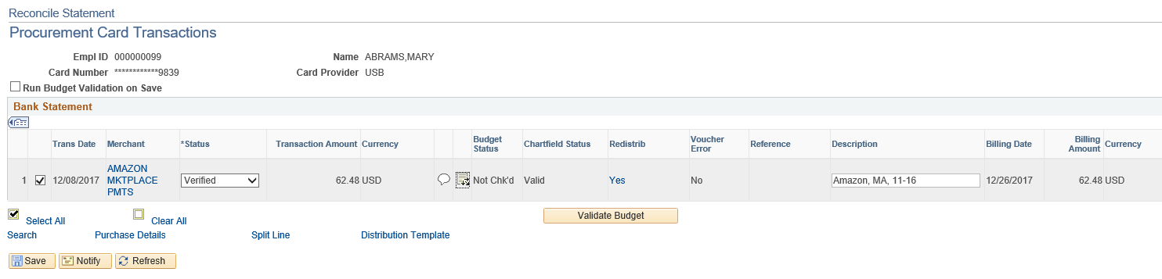
Cardholders Review of Monthly Statement in GEARS – Update the Description Field
Update the Description field for each transaction with the Merchant’s Name.
  Ensure that you include the cardholder’s initials and the statement month and year.
  For example, (“Amazon, MA, 11-16”).
  NOTE: Do not use special characters, such as a backtick (`), colon (:), apostrophe (‘), forward slash (/) or back slash (\).

Slide 30

Cardholders Review of Monthly Statement in GEARS – Reconcile or Correct Distributions
You must perform Budget Check, if any changes are made to the ChartFields. If you do not receive a ‘Valid’ Budget Status (e.g., ‘Error’), contact DBF Budget Unit.

Slide 31

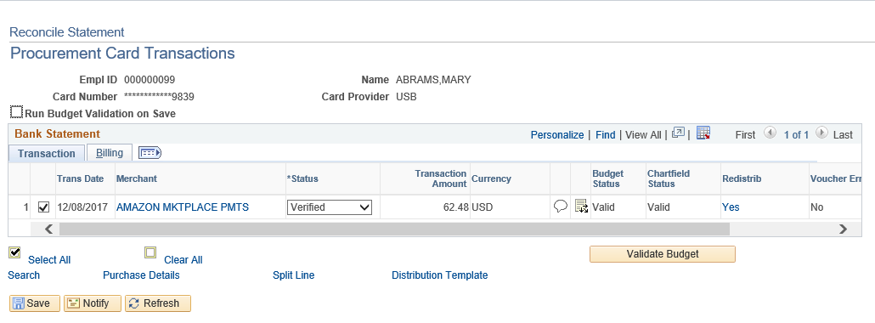
Cardholders Review of Monthly Statement in GEARS – Update the Description Field
Save your changes.

Slide 32

Cardholders Review of Monthly Statement in GEARS – Your Turn

Slide 33
Just Ask…
Any Questions

Slide 34

Thank You!!!

