Slide 1
Travel Policy Review

Slide 2

Introductions:
Tell us a little about yourself:
What’s your name?
Where do you work and what do you do?

Slide 3

Information we’ll be covering:
Review of Travel Policy and website.
The Travel Form, Fields and Checklist.
Practice Completing the Form.
Access and Entry into GEARS.
Tools: Review Vendors. Voucher Activity Inquiry, Find an Existing Voucher, Payment Information.
Practice Entering into GEARS.
Contact Information.
Questions and Answers.
BONUS – What is a GEARS Update?

Slide 4
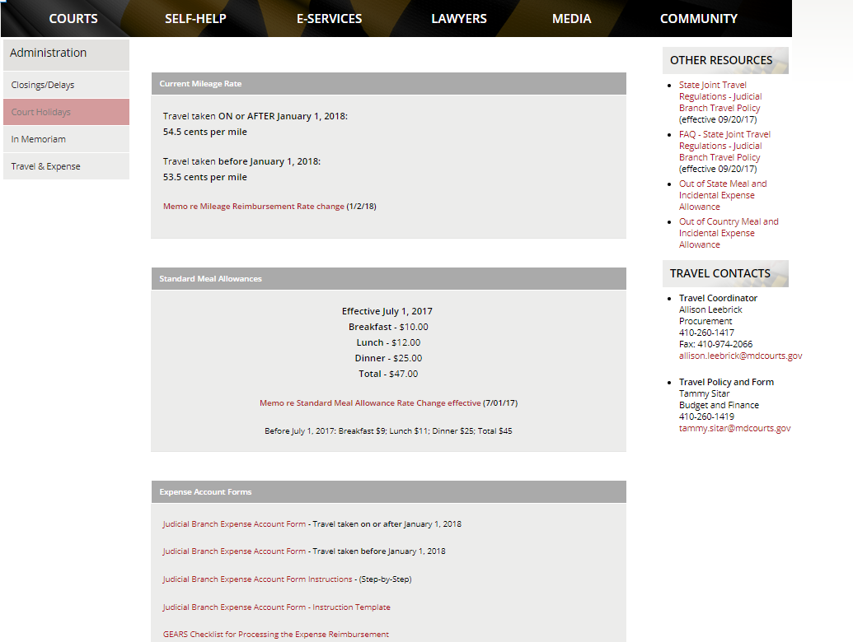

Everything you ever wanted to know about Travel is
on line at http://mdcourts.gov/administration/travel.html

Slide 5

Policy Information:
As always, you may find all travel information and forms on CourtNet at: http://www.courts.state.md.us/administration/travel.html.
Highlights of the policy include:
1. The Standard Meal Allowances as established by the Department of Budget and Management are used for In-State travel.
2. The General Services Administration Per Diem Meal and Incidental Expense rates are used for Out-of-State travel. Details and rates can be found with this link:
http://www.gsa.gov/portal/content/104877
3. The U.S. Department of State Foreign Per Diem Meal and Incidental Expense rates are used for Out-of-Country travel. Details and rates can be found with this link:
https://aoprals.state.gov/web920/per_diem.asp
4. Out-of-State travel, with the exception of Northern Virginia and the District of Columbia, requires written approval in advance.
5. A non-employee volunteer, speaker or applicant is not required to record commute miles. The expense form includes a question as to whether the requestor is a Judiciary employee or not.
6. Agendas must be provided for any conference or workshop which is not held at the JECC and for which meal reimbursement is requested.

Slide 6
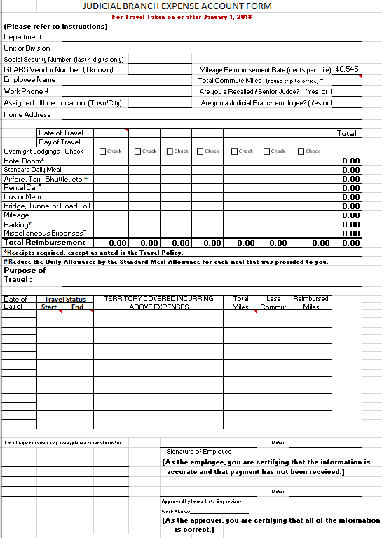

The most current Expense Account Form:
Will not have the fields numbered. (This is the Instruction Template.)
Has a space in the header for Total Commute Miles.
Has check boxes for overnight lodging.
Has question asking whether employee.
Will always be available at: http://mdcourts.gov/administration/travel.html
Remember: Outdated forms will be rejected.

Slide 7

Commute Miles are:
The total miles you travel from home to work and back home each day.
Entered in the Header Section of the Expense Report and will automatically fill in on the lower section when travel is entered correctly.
Subtracted from the Total Miles Traveled.
Applicable to everyone (except Retired Judges, Non-employee Volunteers, Applicants, or Speakers).
Must be deducted even if you are working on a day that you would not typically be working (such as a weekend).
Tips to Remember:
Total Miles Traveled entered on the bottom should be from your home to your destination(s) and then back to home (excluding any personal miles driven).
When one trip involves overnight and multiple days, the total miles can be listed on only the last day, which allows the commute miles to only be deducted once. Territory details should be listed for each day.
The number of Commute Miles should be the same on each Expense Report submitted unless you move.

Slide 8

Current In-State Standard Meal Allowance (7/1/17):
100% (In Travel Status for >24 Hours)
Breakfast $10.00
Lunch $12.00
Dinner $25.00
Daily Allowance $47.00
75% (In Travel Status for >12 Hours)
Breakfast $ 7.50
Lunch $ 9.00
Dinner $18.75
Daily Allowance $35.25
You must be in travel status for more than 12 hours to be eligible for any meal reimbursement. This would include travel within one day.
Start and end times are required on the form to determine any and all meal eligibility.
When in travel status for less than 24 hours in one calendar day, reimbursement is at 100%.
When your travel involves overnight multiple days, meal reimbursement is at 75% on the travel to/from days.
You do not need to provide receipts for meals.
All Meal Allowances must be reduced for all meals (including continental) that were provided by the training or the hotel and whether eaten or not.

Slide 9
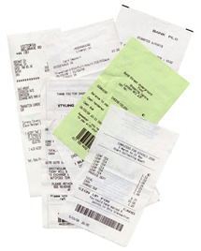
Receipts and Backup:
Receipts are needed for:
Lodging
Air, Rail and Ground Transportation (including allowable tips)
Car Rental
Parking (except when a meter is used)
Miscellaneous Expenses
Backup is needed for:
Out-of-State Travel – A copy of the approval from the Chief Judge or State Court Administrator must be attached.
An agenda is required when meal reimbursement is requested and the event is not held at the Judicial College (JECC).
Reimbursement for meals provided at any function - An attendees list must be attached (not a relevant situation for most).

Slide 10

Tips:
Tips for hotel housekeeping services are not reimbursable.
Tips of up to 15% for ground transportation are reimbursable and must be included on receipt.
Tips for porters and luggage assistance are reimbursable at $1.00 per bag, if you chose to tip.

Slide 11

Form Checklist:
The following items should be carefully checked on each Judicial Branch Expense
Account form & voucher:
The correct form is used and attached.
Can fill all columns starting at the left, as long as in date order.
All required information is entered.
The Department and Unit fields are flexible, but should provide enough information to know where the person works and what their position is.
The total roundtrip commute miles are entered and correct.
The total miles traveled are calculated correctly.
The purpose of travel is completed and understandable.
The date of travel is filled in along with travel status start and end times.

Slide 12
Form Checklist continued:
The following items should be carefully checked on each Judicial Branch Expense
Account form & voucher:
If meals are provided, the Standard Meal Allowance MUST be reduced for the meal allowance for those applicable meals.
Meal reimbursements are reduced to 75% of the Standard Meal Allowance for the first and last travel days of concurrent/overnight travel.
Any Out of State travel must have an approval letter attached from the State Court Administrator or Chief Judge.
Any travel days listed beyond 90 days of request date must receive approval from the State Court Administrator before processing in GEARS.
Ensure that receipts for parking, taxis, vans, shuttles or airport limousines (including tips), Rental Cars, Ferries are attached
Any other required information is provided, such as nature of miscellaneous expenses.
Form is signed by the requestor and their supervisor. If a judge or clerk of court, a supervisor signature is not required.

Slide 13
Misc Information:
When sharing a ride, you are not eligible for any mileage reimbursement, other than what you may have incurred to meet your ride.
If multiple days of travel, display each day in middle of form, whether you incurred any expenses or not. (Do not consolidate into one column.)
Can complete all columns to minimize the quantity of vouchers needed. However, please ensure that all columns are in consecutive date order from left to right.
You cannot claim extra miles because you are starting your trip at a further point than your normal home.

Slide 14
Form Completion: Scenario 1
Jane Smith attended a GEARS training at the JECC on January 16.
Use a fake SS# and home address.
Complete all “required” fields.
She traveled 53 miles round trip.
Breakfast and lunch were provided.
She left at 7am and returned home at 4pm.
Her commute is 24 miles round trip.
Calculate her reimbursement.

Slide 15
Form Completion: Scenario 2
Jane Smith attended a GEARS training at the JECC on January 16.
She was required to stay in a hotel on the 1st two nights, for which she paid $157.00 per night.
She traveled 120 miles round trip.
The following meals were provided:
  Breakfast and lunch on day 2
  Breakfast on day 3
  She was home for dinner on day 3 and she elected not to include this amount for reimbursement.
She left at 7am on day 1 and returned home at 4pm on day 3.
Her commute is 24 miles round trip.
She was required to pay a toll of $4.00 each way.
Calculate her reimbursement. What receipt(s) does she need to include? (Hint - the form indicates the answer!)

Slide 16

What do I need to get access to GEARS?
You need to have a GEARS User ID – Complete the GEARS Security Access form that can be found on the GEARS site. Select the role of “Complete Expense Reports”.
2. Utilize the GEARS production link that can be found on the GEARS site under Launch PeopleSoft.
https://gears.mdcourts.gov/psp/fsprd/?cmd=login&languageCd=ENG&
Remember your password!
4. Contact Service Now for any assistance, 410-260-1114.

Slide 17

What reimbursements should you process in GEARS?
All mileage reimbursement forms should be processed locally in GEARS with the exception of reimbursements that are applicable to grants (i.e. FCCIP/CANDO) and the annual judge’s conference. These forms should be mailed to the respective addresses as indicated on the forms or guidance that is distributed at the events.
Retired Judge forms can be mailed to the AOC, unless the judge has the support of a Judicial Assistant.
What PCA/Speedchart should be used:
Use your court/department expenditure PCA or if processing for a judge:
30001 – Circuit Court Judges
20011 – Court of Special Appeals Judges
20021 – Court of Special Appeals ADR
10061 – Court of Appeals Judges
Accounts:
0401 Instate Travel
0403 Out of State Travel

Slide 18
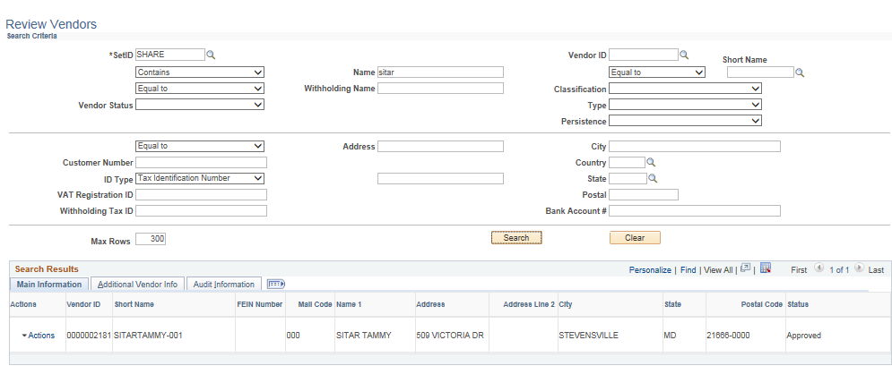

Review Vendors:
The below navigation should be used to determine a “vendor’s” GEARS ID. The best search method is to use the company’s FEIN or person’s Social Security number. (SSN will never display in GEARS, but can be used in your search.) You should also always verify the address. We can have multiple vendors with the same way FEIN, but different addresses.

Slide 19
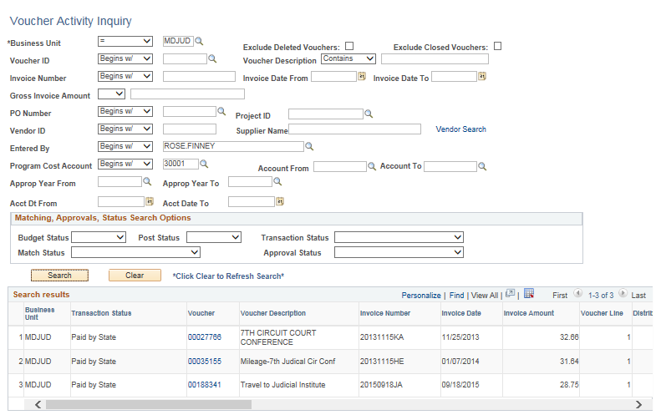

Voucher Activity Inquiry:
This page provides details and statuses on all of the vouchers that you have processed. You will need to enter your name and your PCA. You should also select the check boxes to exclude the deleted and closed vouchers.

Slide 20
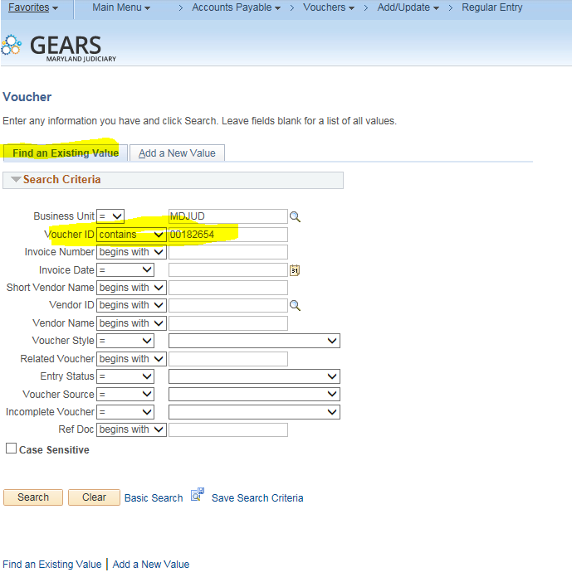

How to Find an Existing Voucher:
Many times, you may receive an email stating that a change needs to happen to a voucher that you created. Please be sure to correct the existing vouchers and not create new vouchers! You may reference the tip sheet, How to Find an Existing Voucher, for assistance. In most cases, you can search directly with the voucher number, but as shown there are many other options.

Slide 21
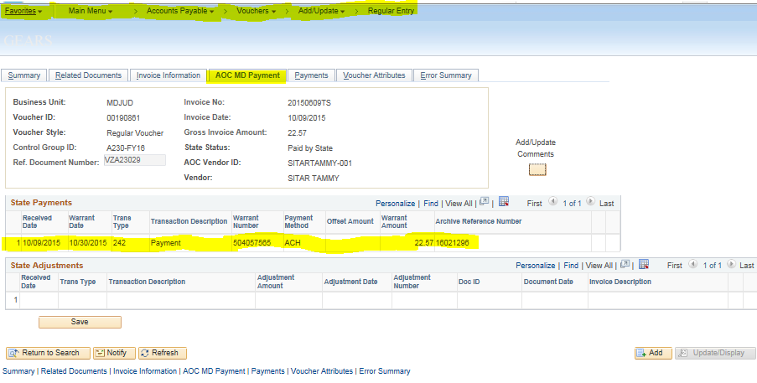

How to see the voucher payment status:
The voucher activity inquiry page will give you payment information, which you can then drill into. Another option is to go directly into the voucher and review the AOC payment page (shown below).

Slide 22
GEARS Checklist:
When entering the expense voucher into GEARS, please ensure each step noted on the Judicial Branch Expense Account Instructions is completed and correct. If using a hard copy of the Judicial Branch Expense Account form, you should verify that the math calculations are correct. Please ensure all required receipts are attached.
Below is a list of “Musts” for entering the voucher into GEARS:
First, determine if you should enter the reimbursement in GEARS or mail it. Expenses incurred as part of a grant (FCCIP/CANDO/etc.) or the annual Judge’s Conference should be mailed to the respective office for processing.
Ensure the invoice number is correct (example: 20150309TV - year/month/first day of travel/two initials in caps – first and last name). When selecting the initials, be sure to follow our standardization.
Where hyphenated or multiple last names are used, the last “last name” is to be utilized in the invoice number for all invoices.
Examples: John Andrews-Sanders, invoice number would utilize the initials JS. Andy Jon De Smith, invoice number would utilize the initials AS.
3. The invoice and accounting date is the date the voucher is entered into GEARS
Ensure coding is correct in the distribution lines.
5. Ensure the reimbursement form has been signed by the employee and supervisor as applicable.
6. Ensure ALL attachments are added (example: the actual expense form, receipts, agenda, approval) and in PDF format.
7. Confirm that the voucher amount and the expense form amount MATCH.
8. Run Budget Check and ensure the final status is “valid.” Resolve any budget checking errors.
9. Ensure you click “Submit for Approval” once the voucher has a successful “Valid” budget status.

Slide 23
Please refer to the Tip Sheet on the GEARS site for entry instructions and call the help desk for support as needed.

Slide 24
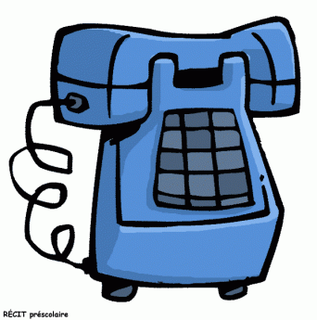
Contact Information:
Tammy Sitar 410-260-1419
Budget and Finance Deputy Director
Travel Plan Administrator
Travel Coordinator, Allison Leebrick 410-260-1417
Unit Director, Accounting Operations,
Brittanie Collier 410-260-1379
Accounts Payable Supervisor, Sharon Hoff 410-260-1412
Accounts Payable Lead Worker, Trudy Brown 410-260-1378
Help Desk 410-260-1114
GEARS Website - http://mdcourts.gov/gears/index.html
For the most comprehensive and up-to-date information, please visit the Travel Policy Website at http://mdcourts.gov/administration/travel.html

Slide 25

Any Questions?

